Slide 1

Manufacturing Defects Analysis
By: Sarah Steinbaum
Notes:
Hello,
In this presentation, I will be addressing the growing number of defects from the manufacturing company in Tijuana, Mexico. I will provide ANOVA hypothesis testing with results and recommendations to address these defects.

Slide 2
Defect Concerns
As our organization grows, the number of defects have increased. These defects include:
Solder bridge
Missing components
Damaged components
Lifted components
Insufficient solder
Excessive solder
Defects are discovered after the boards are through the final assembly process which leads to:
Increased costs
Longer production hours
Requiring specifically qualified workers
Notes:
Our manufacturing company located in Tijuana, Mexico is noticing an increase in defects of their welding process of electric boards and in the components named Thru-Holes after an increase in demand. The defects include the solder bridge, missing components, damaged components, lifted components, insufficient solder, and excessive solder. These defects are being discovered after the boards have gone through the final assembly process which requires increased costs, production hours, and specially qualified workers in order to correct the defects. This manufacturing company seeks to comply with standards that were established by the IPC-A-610E which requires them to correct the defects before the release of their products.

Slide 3

Goals to Address Defects
We have two goals to address the percentage of defects:
A 20% reduction in the defects that are generated in the welding process in the double production lines of the Manual Finish area.
A 20% increase in the capacity of the three double production lines where electronic boards are processed, without the percentage of defects.
Need to comply with IPC-A-610E standards.
Achieving these goals can lead to:
Enhanced product quality
Decreased defects
Increased efficiency
Reduced costs
If not addressed, the defects:
Will continue to increase
Decreased sales
Decreased customers
Impair reputation
Notes:
In order for the manufacturing company to decrease the number of defects they are producing after the final assembly process, the organization must adhere to industry’s best standards by correcting the defects prior to their release. This entails a 20% reduction in defects produced from the welding process as well as a 20% increase in the capacity of the production line. By completing these improvements, the manufacturing company can enhance the product quality to decrease defects, increase organizational efficiency, and reduce costs. If not addressed, the defects will continue to increase, potentially leading to loss of sales and customers due to a reputation of producing poor quality products.

Slide 4
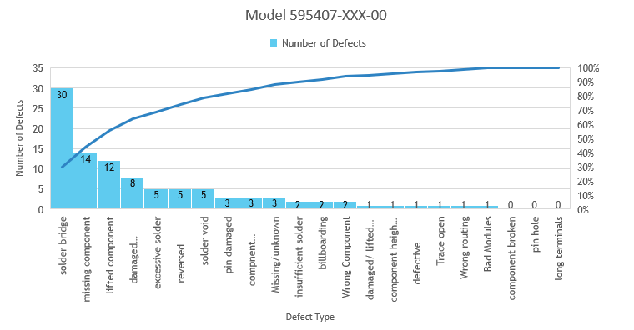
Pareto Charts
The following Pareto Charts summarize the top 20% of defects for each model.
Uses the 80/20 ratio:
80% of the defects stem from 20% of the cause.
The Pareto Chart for Model 1 is displayed below:
Notes:
Each chart summarizes the top 20% of defects for each of the three models. This provides insight into the root cause by comparing the 80/20 ratio to the defects, revealing that 80% of the defects stem from 20% of the causes. These charts offer a visual representation and enable us to prioritize the issues that, when addressed, can contribute to achieving the 20% defects in each area in the facility as well as our second objective of a 20% increase in output production. We can use the list of defects in the top 20% for each model and overall to prioritize our efforts and focus on the ones with the most significant impact on the overall defect rate.
This is the Pareto Chart for Model 1 which portrays the number of defects in light blue and the dark blue line represents the cumulative percentage of the number of defects. The top 20% of defects in this model are solder bridge, missing component, lifted component, and damaged component. The defect types: component broken, pin hole, and long terminals have 0 defects.

Slide 5
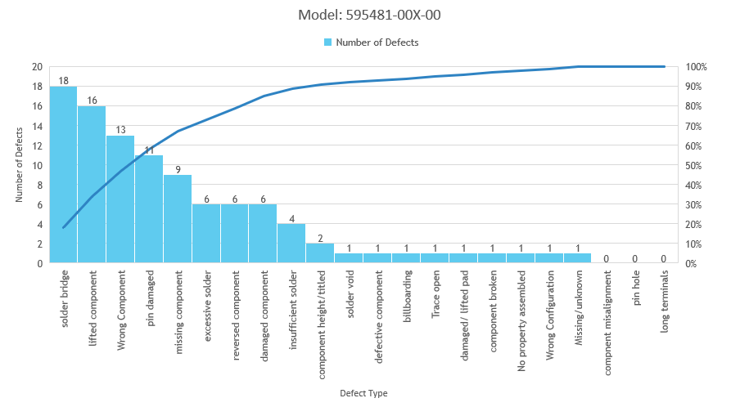
Pareto Chart – Model 2
Notes:
The number of defects in the chart for this model are displayed in light blue and the cumulative average is in dark blue. The top 20% of defects in this model are solder bridge, lifted component, wrong component, pin damaged, missing component, excessive solder, reversed component, damaged component, and insufficient solder. The defect types with 0 defects are component misalignment, pin hole, long terminals.

Slide 6
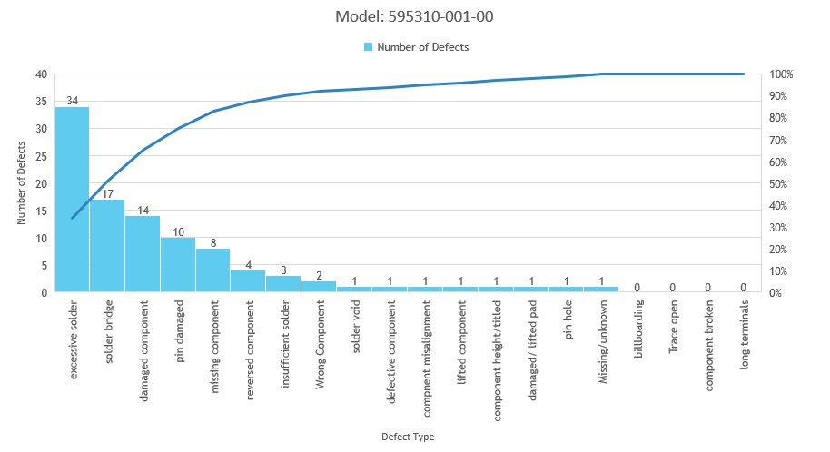
Pareto Chart – Model 3
Notes:
This model also utilizes light blue to portray the number of defects and dark blue to display the cumulative average. The top 20% of defect types in this model are excessive solder, solder bridge, damaged component, pin damaged, and missing component. The defect types with 0 defects in this model are billboarding, trace open, component broken, and long terminals.

Slide 7
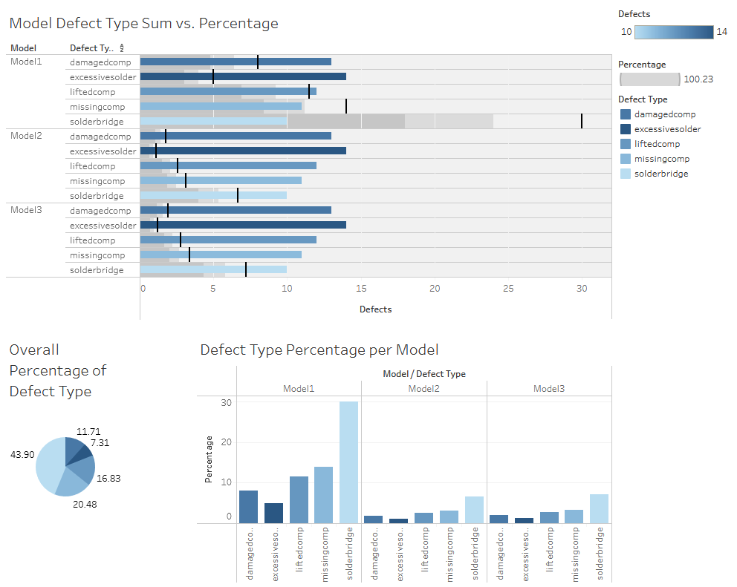
Notes:
This interactive dashboard, created using Tableau, provides a comprehensive view of the defect type sum versus the percentage, the overall percentage of defect type, and the defect type percentage per model. The labels are on the right-hand side showing the percentage is grey and the lightest color blue signifies a lower sum of defects while the darker shade signifies a larger sum of defects.
The top portion portrays the effect type per model in a bar graph. The sum of defects is in a shade of blue and the percentage is in grey. The black line signifies the average percentage. The pie chart in bottom left corner displays the average percentage of each defect type of all three models. The bar graph next to it on the right shows the defect type percentage per model.
Model 1 has a significantly higher percentage of defects compared to the other two models. The defect type, solder bridge, makes up almost half the amount of defects at 43.9%.

Slide 8
Hypothesis Test
A hypothesis test was conducted to determine if there is a statistically significant difference in the percentage of defects in comparison to the other two production lines.
A One-way ANOVA test was conducted using the following hypotheses:
Null Hypothesis (H₀): There is no significant difference between the means μ1=μ2=μ3
Alternative Hypothesis (H_{a}): There is at least one significant difference between the means. (μ1≠μ2≠μ3) α = 0.05
Notes:
A hypothesis test was conducted in order to understand if there is a statistically significant difference in the percentage of defects in comparison to the other two production lines. If a statistically significant difference does exist, it will indicate that the production lines with the highest number of defects should have those defects corrected. We will use data from production with the highest number of defect percentage to conduct the hypothesis test.
Null Hypothesis (H₀): There is no significant difference between the means μ1=μ2=μ3
Alternative Hypothesis (H_{a}): There is at least one significant difference between the means. (μ1≠μ2≠μ3) α = 0.05

Slide 9
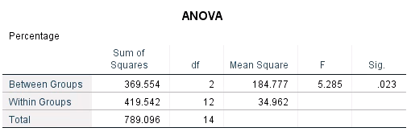
ANOVA Testing
A One-way Analysis of Variance (ANOVA) hypothesis test was utilized to determine if we have sufficient evidence to reject or accept the null hypothesis.
Variables:
Models (Independent variable)
Defects Percentage (Dependent variable)
F-statistic: 5.285
P-value: 0.023
Notes:
A One-way Analysis of Variance (ANOVA) hypothesis test was conducted to determine if we have sufficient evidence to reject or accept the null hypothesis. The parameters used for this test are the models as the independent variable and the defects percentage as the dependent variable. These parameters were chosen as the results derived from using these parameters are most relevant to solving the organizational problem.
The One-Way ANOVA test produced results for sum of squares, degree of freedom, mean square, F-statistic, and the significance, or p-value. The F-statistic is 5.285 and the significance, or p-value, is 0.023. Since we are using a level of significance of 0.05 and our p-value is less than that at 0.023, we can reject the null hypothesis that there is no significance between the three means.

Slide 10
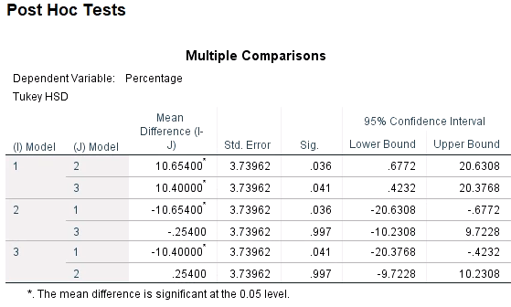
Post Hoc Tests – Multiple Comparisons
Post Hoc tests show the results of the ANOVA test in more detail.
The Multiple Comparisons test evaluates each group and shows the relationship between the models.
Models with a level of significance less than 0.05 are statistically significant:
(I) Model 2/ (J) Model 3
(I) Model 3/ (J) Model 2
Notes:
Post Hoc tests shows the results of the ANOVA test in more detail. After conducting the ANOVA test, we determined that we could reject the null hypothesis as at least one of the models is statistically significant, however, the ANOVA test does not specify the model.
The Post Hoc test allows us to see exactly which models have a statistically significant difference.
The multiple comparison test evaluates each group and shows the relationship between the models. Since the level of significance is 0.05, only values under the Sig. column that are greater than 0.05 are considered statistically significant. This means that (I) Model 2/ (J) Model 3 is statistically significant as its value is 0.997 and (I) Model 3/ (J) Model 2 is statistically significant as its value is also 0.997.

Slide 11
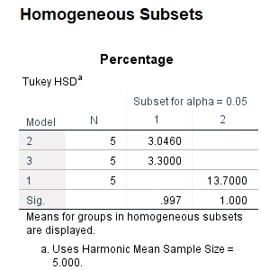
Post Hoc Tests – Homogeneous Subsets
The Homogeneous Subsets test is used to focus on the groups with significant difference between the models.
The means for Model 1 are higher than those of Models 2 and 3.
Notes:
The Homogeneous Subsets test allows us to focus where there was a significant difference between the groups.
It shows that the means for Model 1 is significantly higher than Model 2 and Model 3. Additionally, it demonstrates that Models 2 and 3 are not significantly different because they are in the same column from Model 1.

Slide 12
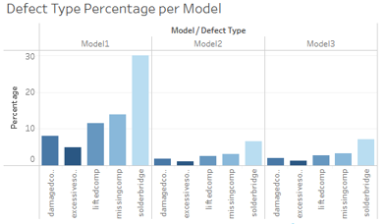
Results and Recommendations
Model 1 has a higher mean defect rate than the other two models.
The solder bridge was the defect type that had the highest percentage of defects in all three models.
By prioritizing Model 1 and the solder bridge defect, our organization should meet its goal of a 20% reduction in defects during the welding processes, while also achieving a 20% increase in the capacity of the three double production lines.
Notes:
After reviewing the data from the Pareto charts, Tableau dashboard, ANOVA test results, and Post Hoc test results, Model 1 has a higher mean defect rate than the other two models. Additionally, the solder bridge was the defect type that had the highest percentage of defects in all three models.
Due to its higher mean defect rate and significant difference to the other models, Model 1 would be the optimum place to start. By prioritizing Model 1, then expanding to the other production lines, the defects can be corrected on the production line with highest mean percentage of defect first. In this case, the solder bridge. The focus should then be expanded to the other models to continue to correct the defects.
This plan will allow the company to correct the defects as quickly and efficiently as possible. This would allow us to reach the two goals of the project of a 20% reduction in defects during the welding processes, while also achieving a 20% increase in the capacity of the three double production lines. Additionally, following this plan would assist us in being compliant with the Standard IPC-A-610E.
By completing these improvements, we can optimize quality of our products, improve efficiency, and decrease costs.

Slide 13
References
Libguides: SPSS tutorials: One-way anova. One-Way ANOVA - SPSS Tutorials - LibGuides at Kent State University. (n.d.). https://libguides.library.kent.edu/spss/onewayanova
One-way ANOVA in SPSS statistics. One-way ANOVA in SPSS Statistics - Step-by-step procedure including testing of assumptions. (n.d.). https://statistics.laerd.com/spss-tutorials/one-way-anova-using-spss-statistics.php
How to conduct a root cause analysis. The Compass for SBC. (2022, April 21). https://thecompassforsbc.org/how-to-guide/how-conduct-root-cause-analysis
Create a Dashboard. Tableau. (n.d.). https://help.tableau.com/current/pro/desktop/en-us/dashboards_create.htm

